Slide 1

EV Charging Infrastructure Intelligence Dashboard
Power BI Data Analytics Project
Presented By –
Atharv Milind Suryavanshi
Shreedhar Sanjay Kumbhar
Department of Computer Science & Engineering DKTE Society's Yashwantrao Chavan Polytechnic, Ichalkaranji
Academic Year: 2026 – 27
1

Slide 2
Project Overview
From raw EV station data to an interactive BI dashboard
Purpose
Workflow
• Analyze EV charging infrastructure across countries, regions and operators.
• Clean and standardize raw station data using Power Query.
• Create calculated columns and analytical measures using DAX.
• Present results through three interactive Power BI pages.
• Generate insights for infrastructure and operational analysis.
• Raw Dataset
• Data Inspection & Cleaning
• Power Query Transformation
• Calculated Columns & DAX Measures
• Dashboard Development
• Insights & Conclusion
2

Slide 3
Dataset & Data Preparation
Key steps used to make the dataset analysis-ready
Dataset
Cleaning & Transformation
• Missing-value handling
• Duplicate checking
• Column renaming
• Text trimming
• Country-name standardization
• Operator and status standardization
• Connector-type transformation
• Latitude/longitude validation
• Charging capacity categories
• 10,000 original station records
• 14 original columns
• Station, location, operator, status, connector and date information
• Multiple countries and geographic regions
3

Slide 4
Power Query, M Language & DAX
The transformation and calculation layer
Power Query / M Language
Calculated Columns & Measures
• Missing-value handling
• Duplicate checks
• Text cleaning
• Country mapping
• Operator cleaning
• Status standardization
• Connector transformation
• Geographic validation
• Capacity categorization
• Station Age
• Connector Category
• Operational Flag
• Connector Capacity Group
• Country Region
• Total Stations
• Operational Stations
• Non Operational Stations
• Total Connectors
• Average Connectors per Station
• Operational %
• Top Operator
4

Slide 5
Dashboard Structure
Three pages for overview, comparison and detailed investigation
01 Executive Overview
02 Infrastructure Analysis
03 Station Details
• KPIs, country distribution, map, operational status, monthly connectors and capacity.
• Interactive navigation
• Filters / slicers
• Detailed investigation
• Operators, regions, connector types, capacity and country/status comparison.
• Interactive navigation
• Filters / slicers
• Detailed investigation
• Station-level records, capacity distribution and regional operational summary.
• Interactive navigation
• Filters / slicers
• Detailed investigation
5

Slide 6
Page 1: Executive Overview
High-level view of the EV charging infrastructure
10K
9K
626
93.46%
14K
Total Stations
Operational Stations
Non Operational Stations
Operational %
Total Connectors
Main Visuals
Insights
• Top 5 Countries
• Countries With EV Stations map
• Operational vs Non Operational
• Connectors by Month
• Charging Capacity Category
• Canada: about 3.8K stations
• United States: about 2.2K
• Operational share: 93.46%
• June has about 9.4K connectors in the monthly chart
• Geographic distribution is concentrated in selected regions
6

Slide 7
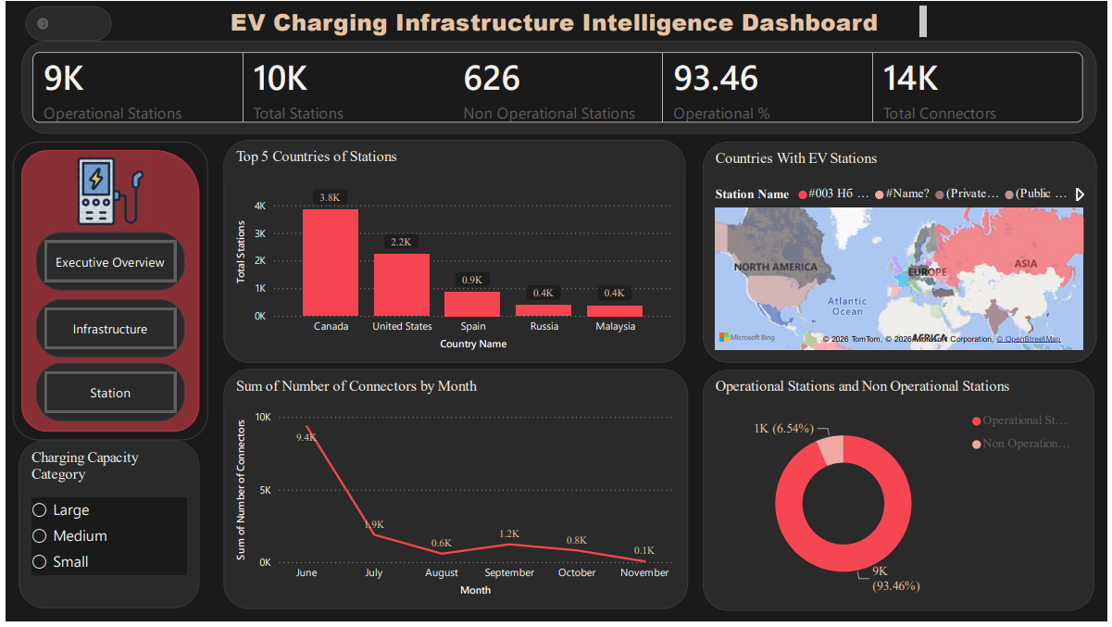
Page 1: Executive Overview
6

Slide 8
Page 2: Infrastructure Analysis
Comparing operators, regions, connectors and capacity
Operator & Regional Findings
Capacity & Connector Findings
• Average Connectors per Station: 1.46
• Top Operator: Circuit Electrique
• Circuit Electrique: about 2.0K stations
• Chargepoint: about 1.3K stations
• FLO: about 0.7K stations
• North America is the dominant region
• Small stations: about 70.99%
• Medium stations: about 27.89%
• Large stations: very small share
• Type 1 (J1772) is prominent in connector analysis
• Country/status charts enable detailed comparison
7

Slide 9
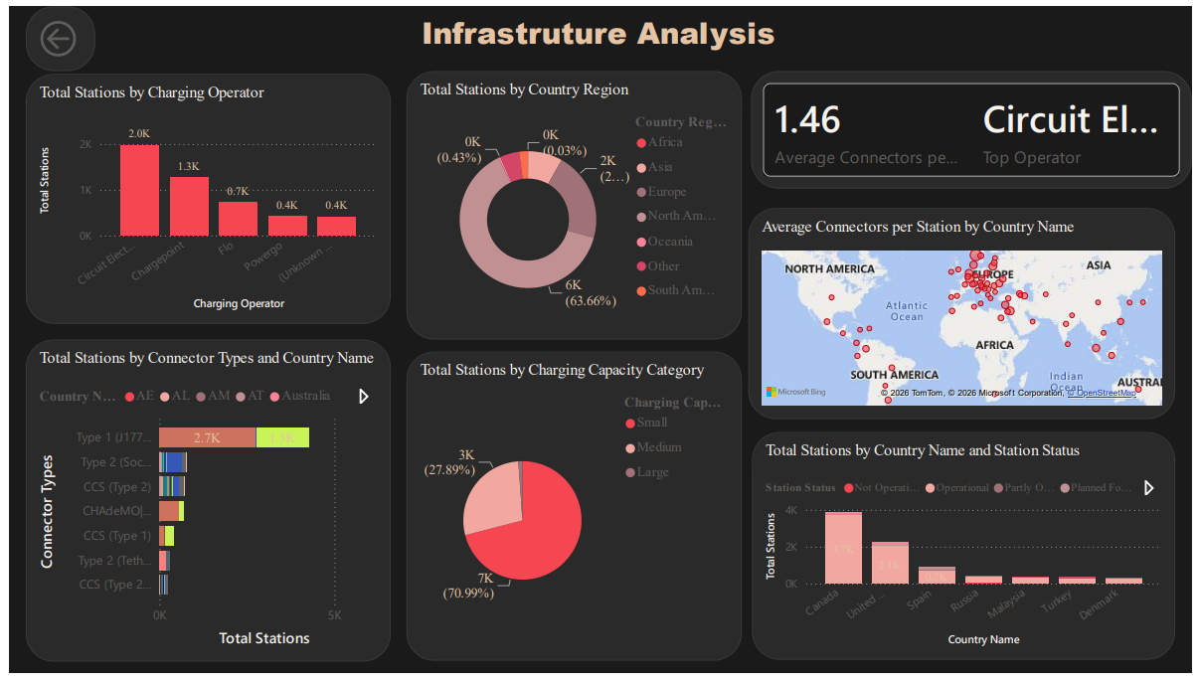
Page 2: Infrastructure Analysis
6

Slide 10
Page 3: Station Details & Drillthrough
From aggregate results to station-level investigation
Station-Level Table
Regional Summary
• Station ID
• Country Name
• Charging Operator
• Total Connectors
• Operational Flag
• Detailed station records
• Charging capacity distribution
• North America: 6,092 total; 5,828 operational; 264 non-operational
• Europe: 2,017 total; 1,792 operational; 225 non-operational
• Asia: 782 total; 701 operational; 81 non-operational
• South America: 199 total; 173 operational; 26 non-operational
8

Slide 11
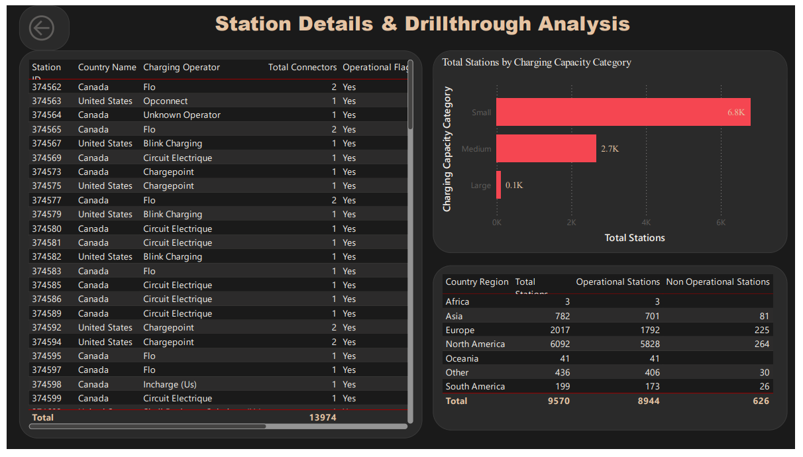
Page 3: Station Details & Drillthrough
6

Slide 12
Key Insights
Major findings from the completed dashboard
1
High operational availability
93.46% of stations are reported as operational.
2
North America dominates
6,092 stations are shown in the regional summary.
3
Canada leads
About 3.8K stations in the Top 5 country chart.
4
Operator concentration
Circuit Electrique is the leading displayed operator at about 2.0K stations.
5
Small stations dominate
Small capacity represents about 70.99% of stations.
9

Slide 13
Data Consistency Observation
A validation point identified from the completed dashboard
Executive Overview
Station Details Regional Table
• Total Stations: 10K
• Operational Stations: 9K
• Non Operational Stations: 626
• Operational %: 93.46%
• Total Connectors: 14K
• Regional total: 9,570 stations
• Operational: 8,944
• Non Operational: 626
• The non-operational count matches the overview.
• The total differs from the 10K headline, so filter/context consistency should be checked.
10

Slide 14
Business Value
How the dashboard supports analysis and decision-making
Infrastructure Planning
Operator Analysis
Operational Analysis
• Compare countries and regions
• Analyze capacity distribution
• Identify areas for further investigation
• Compare operator station counts
• Understand operator concentration
• Identify unknown operator data
• Monitor operational status
• Compare regional performance
• Investigate station-level records
11

Slide 15
Future Scope
Potential extensions beyond the current dashboard
Advanced Analytics
Dashboard Enhancements
• Real-time charging station APIs
• Charging power and AC/DC analysis
• EV registrations and population integration
• Predictive charging-demand analysis
• Geographic optimization for new locations
• Automated refresh
• Station utilization and availability trends
• Distance-to-nearest-station analysis
• Operator reliability and growth analysis
• Infrastructure expansion recommendations
12

Slide 16
Conclusion
Summary of the completed project
• The project transforms raw EV charging station data into an interactive Power BI intelligence dashboard.
• Power Query and M Language clean, standardize and transform the dataset.
• DAX calculated columns and measures create meaningful analytical indicators.
• The three pages provide executive overview, infrastructure comparison and station-level investigation.
• The dashboard highlights high operational availability, strong North American concentration, Canada as the leading displayed country, Circuit Electrique as the leading displayed operator, and dominance of small stations.
• The solution provides a foundation for future real-time, predictive and geographic EV infrastructure analytics.
Thank You
13

